Slide 1


Lecture 1-3
DLI
Algorithms and Convergence

Slide 2
DLI
Introduction
An algorithm is a procedure that describes, in an unambiguous manner, a finite sequence of steps to be performed in a specified order.
The object of the algorithm is to implement a procedure to solve a problem or approximate a solution to the problem.

Slide 3
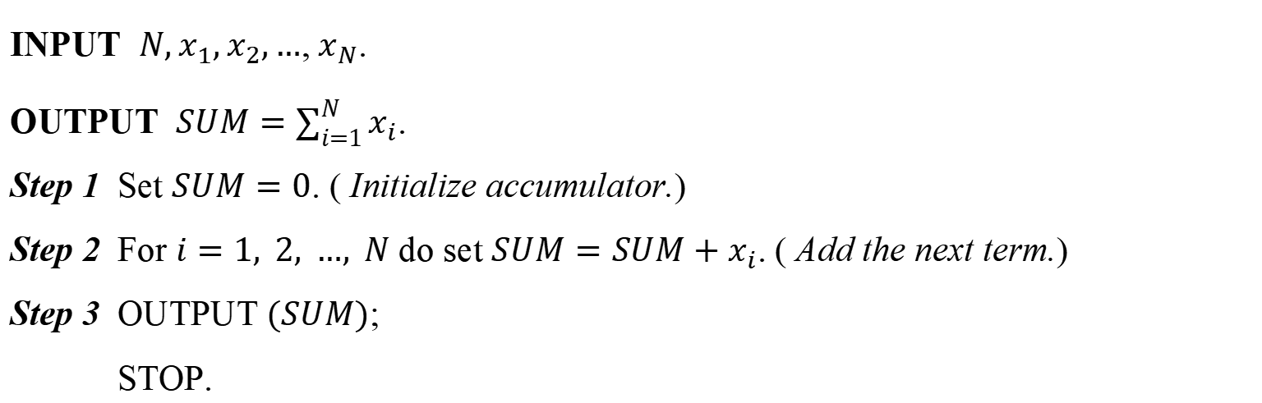
DLI
Illustration
The following algorithm computes $x_{1}+x_{2}+…+x_{N}=\sum_{i=1}^{N}{x_{i}}$,
given $N$ and the numbers $x_{1},x_{2},…$, $x_{N}$.
INPUT $N,x_{1},x_{2},…\text{,} x_{N}\text{.}$
OUTPUT $SUM=\sum_{i=1}^{N}{x_{i}}$.
Step 1 Set $SUM=0$. ( Initialize accumulator.)
Step 2 For $i=1, 2, …, N$ do set $SUM=SUM+x_{i}$. ( Add the next term.)
Step 3 OUTPUT $(SUM)$;
STOP.

Slide 4


DLI
Example 1
The $N$th Taylor polynomial for $f\left(x\right)=\ln{x}$ expanded about $x_{0}=1$ is
$P_{N}\left(x\right)=\sum_{i=1}^{N}{\frac{{(−1)}^{i+1}}{i}}{(x−1)}^{i}$,
and the value of $\ln{1.5}$ to eight decimal places is 0.40546511. Construct an algorithm
to determine the minimal value of $N$ required for
$\left|\ln{1.5}−P_{N}\left(1.5\right)\right|<{10}^{−5}$,
without using the Taylor polynomial remainder term.
Solution:

Slide 5
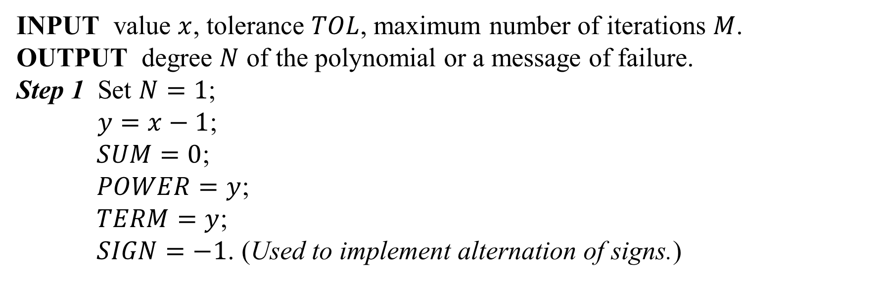
DLI
INPUT value $x$, tolerance $TOL$, maximum number of iterations $M$.
OUTPUT degree $N$ of the polynomial or a message of failure.
Step 1 Set $N=1$;
$y=x−1$;
$SUM=0$;
$POWER=y$;
$TERM=y$;
$SIGN=−1$. (Used to implement alternation of signs.)

Slide 6
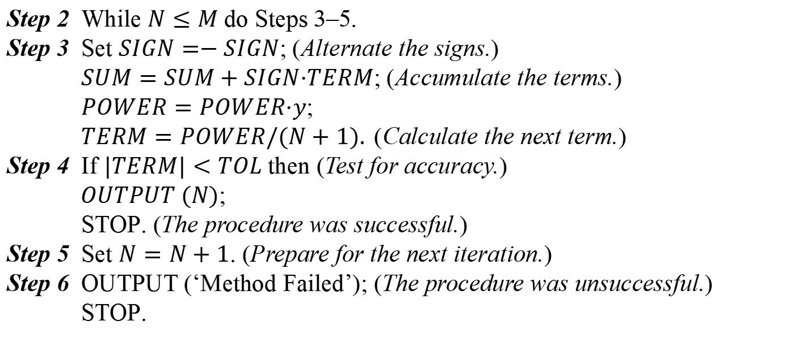
DLI
Step 2 While $N≤M$do Steps 3–5.
Step 3 Set $SIGN=−SIGN$; (Alternate the signs.)
$SUM=SUM+SIGN·TERM$; (Accumulate the terms.)
$POWER=POWER·y$;
$TERM=POWER/(N+1).$(Calculate the next term.)
Step 4 If $|TERM|<TOL$then (Test for accuracy.)
$OUTPUT (N)$;
STOP. (The procedure was successful.)
Step 5 Set $N=N+1$. (Prepare for the next iteration.)
Step 6 OUTPUT (‘Method Failed’); (The procedure was unsuccessful.)
STOP.

Slide 7
DLI
Characterizing Algorithms
Criterion: small changes in the initial data produce correspondingly small changes in the final results
An algorithm that satisfies this property is called stable; otherwise it is unstable.
Some algorithms are stable only for certain choices of initial data, and are called conditionally stable.

Slide 8
DLI
Example Compute $I_{n}=e^{−1}\int_{0}^{1}{x^{n}e^{x}}dx(n=0,1,⋯)$ and evaluate its error.

Slide 9
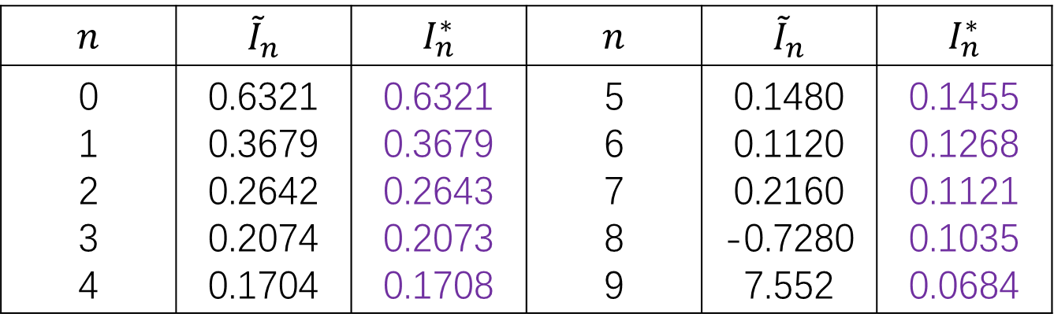
DLI
Example Compute $I_{n}=e^{−1}\int_{0}^{1}{x^{n}e^{x}}dx(n=0,1,⋯)$ and evaluate its error.
$$n$$ | $${\tilde{I}}_{n}$$ | $$I_{n}^{∗}$$ | $$n$$ | $${\tilde{I}}_{n}$$ | $$I_{n}^{∗}$$
0 1 2 3 4 | 0.6321 0.3679 0.2642 0.2074 0.1704 | 0.6321 0.3679 0.2643 0.2073 0.1708 | 5 6 7 8 9 | 0.1480 0.1120 0.2160 -0.7280 7.552 | 0.1455 0.1268 0.1121 0.1035 0.0684

Slide 10
DLI
Definition 1.17
Suppose that $E_{0}>0$denotes an error introduced at some stage
in the calculations and $E_{n}$ represents the magnitude of the error after $n$ subsequent
operations.
$\text{•}$ If $E_{n}≈CnE_{0}$, where $C$ is a constant independent of $n$, then the growth of error is
said to be linear.
$\text{•}$ If $E_{n}≈C^{n}E^{0}$, for some $C>1$, then the growth of error is called exponential.
Linear growth of error is usually unavoidable, and when $C$ and $E_{0}$ are small the
results are generally acceptable. Exponential growth of error should be avoided,
because the term $C^{n}$ becomes large for even relatively small values of $n$. This leads
to unacceptable inaccuracies, regardless of the size of $E_{0}$.

Slide 11
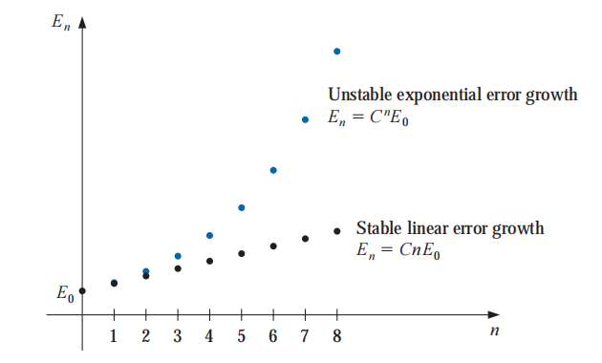
DLI
an algorithm that exhibits linear growth of error is stable, whereas an algorithm exhibiting exponential error growth is unstable.

Slide 12


DLI
Illustration
For any constants $c_{1}$ and $c_{2}$,
$p_{n}=c_{1}{(\frac{1}{3})}^{n}+c_{2}3^{n}$,
is a solution to the recursive equation
$p_{n}=\frac{10}{3}p_{n−1}−p_{n−2}$, for $n=2,3,…$
Suppose that we are given $p_{0}=1$ and $p_{1}=\frac{1}{3}$. As $c_{1}=1$and $c_{2}=0$. So $p_{n}={(\frac{1}{3})}^{n}$ for all $n$.

Slide 13
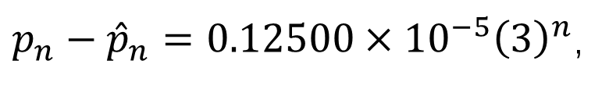
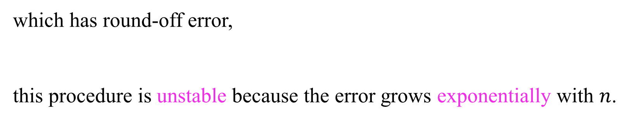
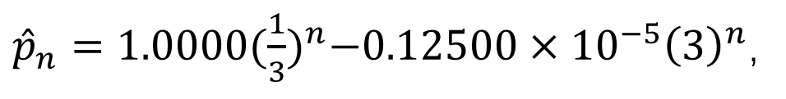
DLI
If five-digit rounding arithmetic is used, then ${\hat{p}}_{0}=1.0000$ and ${\hat{p}}_{1}=0.3333$, which requires modifying the constants to ${\hat{c}}_{1}=1.0000$ and ${\hat{c}}_{2}=−0.12500×{10}^{−5}$.
${\hat{p}}_{n}=1.0000{(\frac{1}{3})}^{n}−0.12500×{10}^{−5}{\left(3\right)}^{n}$,
which has round-off error,
this procedure is unstable because the error grows exponentially with $n$.
$p_{n}−{\hat{p}}_{n}=0.12500×{10}^{−5}{\left(3\right)}^{n}$,

Slide 14
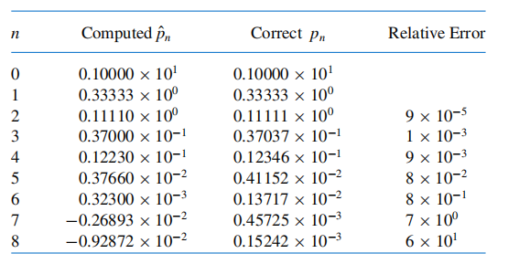
DLI
Table 1.5

Slide 15
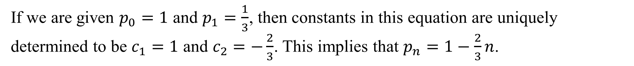
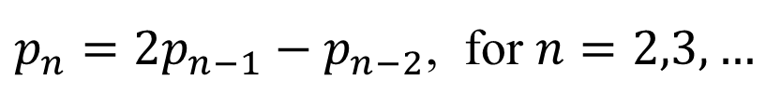
DLI
Now consider this recursive equation:
$p_{n}=2p_{n−1}−p_{n−2}$, for $n=2,3,…$
It has the solution $p_{n}=c_{1}+c_{2}n$ for any constants $c_{1}$ and $c_{2}$.
If we are given $p_{0}=1$ and $p_{1}=\frac{1}{3}$, then constants in this equation are uniquely determined to be $c_{1}=1$ and $c_{2}=−\frac{2}{3}$. This implies that $p_{n}=1−\frac{2}{3}n$.

Slide 16
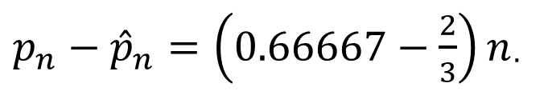
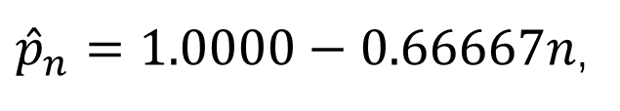
DLI
If five-digit rounding arithmetic is used, then ${\hat{p}}_{0}=1.0000$ and ${\hat{p}}_{1}=0.33333$. The five-digit rounding constants are ${\hat{c}}_{1}=1.0000$ and ${\hat{c}}_{2}=−0.66667$. Thus
${\hat{p}}_{n}=1.0000−0.66667n$,
which has round-off error
${p_{n}−\hat{p}}_{n}=\left(0.66667−\frac{2}{3}\right)n$.
This procedure is stable because the error grows linearly with $n.$

Slide 17
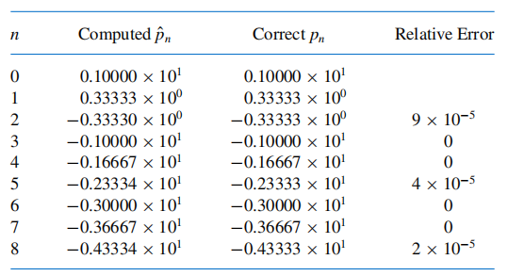
DLI
Table 1.6

Slide 18
DLI
The effects of round-off error can be reduced by using high-order-digit arithmetic such as the double- or multiple-precision option available on most computers.
Disadvantages in using double-precision arithmetic are that it takes more computation time and the growth of round-off error is not entirely eliminated.
One approach to estimating round-off error is to use interval arithmetic (that is, to
retain the largest and smallest possible values at each step), in the end, we obtain
an interval that contains the true value.

Slide 19
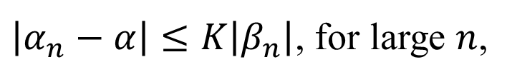
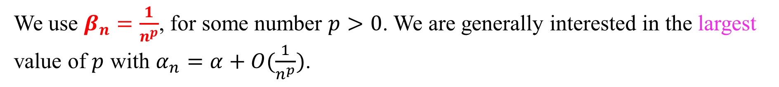
DLI
Rates of Convergence
Definition 1.18
Suppose ${\left\{β_{n}\right\}}_{n=1}^{∞}$is a sequence known to converge to zero, and
${\left\{α_{n}\right\}}_{n=1}^{∞}$converges to a number $α$. If a positive constant $K$ exists with
$\left|α_{n}−α\right|≤K\left|β_{n}\right|$, for large $n$,
then we say that ${\left\{α_{n}\right\}}_{n=1}^{∞}$ converges to $α$ with rate, or order, of convergence $O(β_{n})$.
It is indicated by writing $α_{n}=α+O(β_{n})\text{.}$
We use $β_{n}=\frac{1}{n^{p}}$, for some number $p>0$. We are generally interested in the largest value of $p$ with $α_{n}=α+O(\frac{1}{n^{p}})\text{.}$

Slide 20
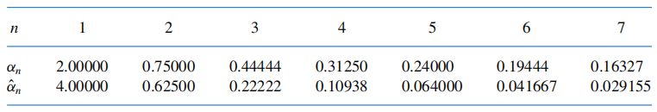

DLI
Example 2
Suppose that, for $n≥1$,
$α_{n}=\frac{n+1}{n^{2}}$ and ${\hat{α}}_{n}=\frac{n+3}{n^{3}}$
Both ${lim⁡}_{n→∞}α_{n}=0$ and ${lim⁡}_{n→∞}{\hat{α}}_{n}=$0, but the sequence $\left\{{\hat{α}}_{n}\right\}$ converges to this
limit much faster than the sequence $\left\{α_{n}\right\}$. Using five-digit rounding arithmetic we have
the values shown in Table 1.7. Determine rates of convergence for these two sequences.
Table 1.7

Slide 21
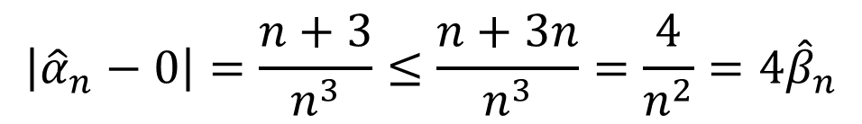
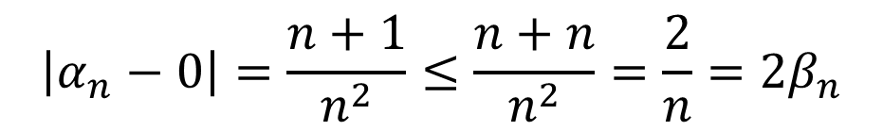
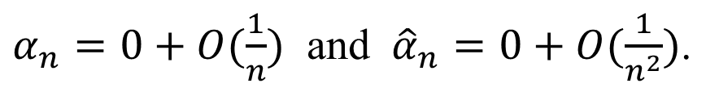
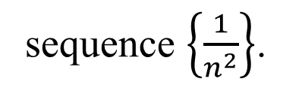
DLI
Solution:
Define the sequences $β_{n}=\frac{1}{n}$ and ${\hat{β}}_{n}=\frac{1}{n^{2}}$. Then
$$\left|α_{n}−0\right|=\frac{n+1}{n^{2}}≤\frac{n+n}{n^{2}}=\frac{2}{n}=2β_{n}$$
and
$$\left|{\hat{α}}_{n}−0\right|=\frac{n+3}{n^{3}}≤\frac{n+3n}{n^{3}}=\frac{4}{n^{2}}=4{\hat{β}}_{n}$$
Hence the rate of convergence of $\left\{α_{n}\right\}$ to zero is similar to the convergence of $\left\{\frac{1}{n}\right\}$
to zero, whereas $\left\{{\hat{α}}_{n}\right\}$ converges to zero at a rate similar to the more rapidly convergent
sequence $\left\{\frac{1}{n^{2}}\right\}$.
$α_{n}=0+O(\frac{1}{n})$ and ${\hat{α}}_{n}=0+O(\frac{1}{n^{2}})$.

Slide 22
DLI
Definition 1.19
Suppose that $\lim_{h→0}G\left(h\right)=0$ and $\lim_{h→0}F\left(h\right)=L$. If a positive
constant $K$ exists with
$\left|F(h)−L\right|≤K\left|G(h)\right|$, for sufficiently small $h$,
then we write $F\left(h\right)=L+O(G\left(h\right))$.
The functions for comparison generally have the form $G\left(h\right)=h^{p}$, where $p>0$. We are interested in the largest value of $p$ for which $F\left(h\right)=L+O(h^{p})$.

Slide 23
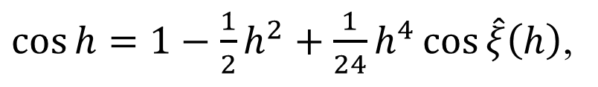

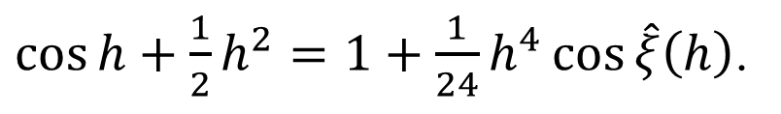
DLI
Example 3
Use the third Taylor polynomial about $h=0$to show that
$\cos{h+\frac{1}{2}h^{2}}=1+O(h^{4})$.
Solution:
$\cos{h}=1−\frac{1}{2}h^{2}+\frac{1}{24}h^{4}\cos{\hat{ξ}\left(h\right)}$,
for some number $\hat{ξ}\left(h\right)$ between zero and $h$. This implies that
$\cos{h}+\frac{1}{2}h^{2}=1+\frac{1}{24}h^{4}\cos{\hat{ξ}\left(h\right)}$.

Slide 24
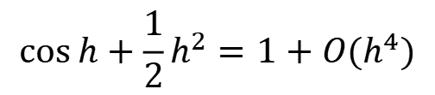
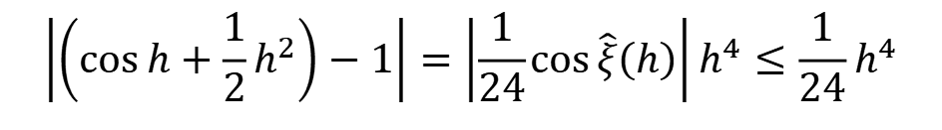
DLI
Hence
$$\left|\left(\cos{h+\frac{1}{2}h^{2}}\right)−1\right|=\left|\frac{1}{24}\cos{\hat{ξ}\left(h\right)}\right|h^{4}≤\frac{1}{24}h^{4}$$
so as $h→0$, $\cos{h+\frac{1}{2}h^{2}}$ converges to its limit, 1, about as fast as $h^{4}$ converges to 0.
That is,
$$\cos{h+\frac{1}{2}h^{2}}=1+O(h^{4})$$
Maple uses the $O$ notation to indicate the form of the error in Taylor polynomials and
in other situations.

Slide 25
DLI
Some principles of avoiding loss of significant figures
Avoid the case of $\frac{x}{y}$, if $0<|y|≪|x|$.
Avoid the subtraction of nearly equal numbers
Avoid the big number eats the small one
Reduce the number of arithmetic calculations

